Slide 1
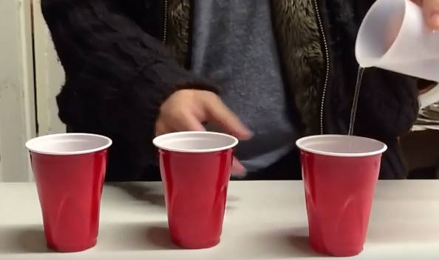
Anchoring Phenomenon: A magic trick.
Disappearing water?
Notes:
https://www.youtube.com/watch?v=dYjNHtF8A1M for full instructions. Basically, put a bit of slush powder in the bottom of the cup, the water will turn into a solid.

Slide 2
The Science of Biology
1.1 What is Science?

Slide 3
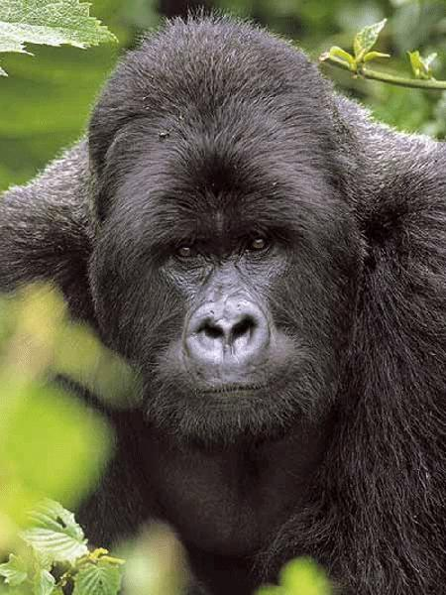
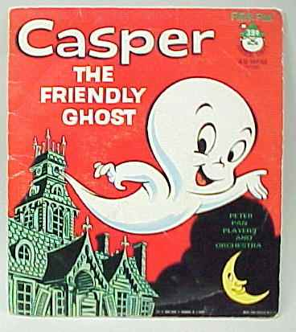
The Goals of Science
1. Deals only with the natural world
The supernatural is outside the realm of science

Slide 4
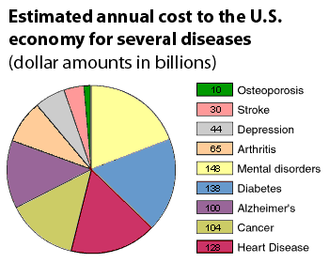
2. Collect and Organize Information

Slide 5
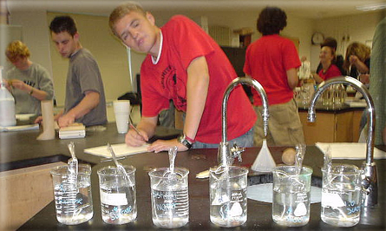
3. Propose explanations that can be tested

Slide 6
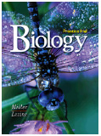
Summarizing..............
SCIENCE is a body of knowledge that explains the natural world.

Slide 7
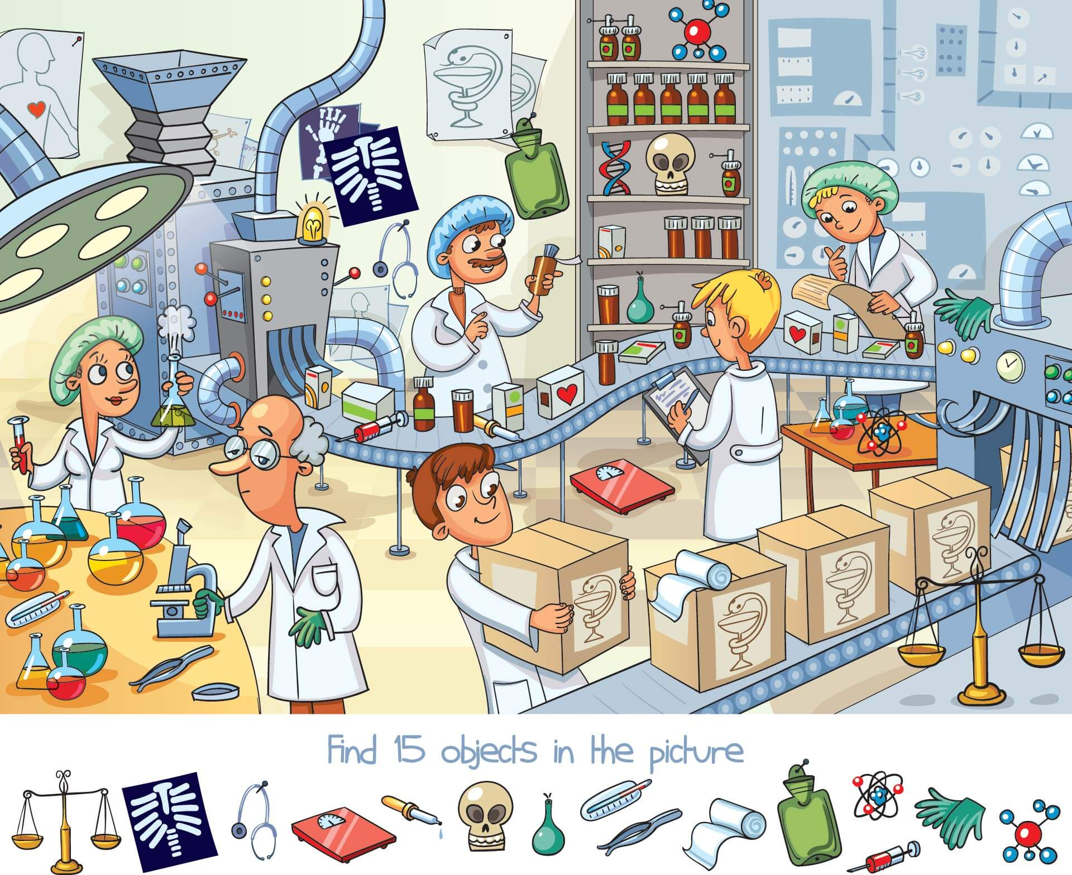
Science Begins with OBSERVATIONS

Slide 8
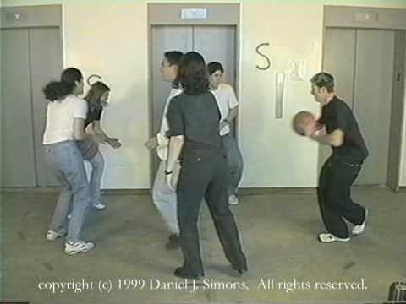
Selective Attention

Slide 9
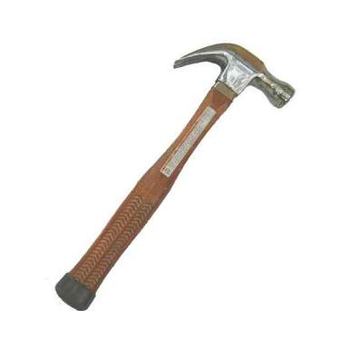
Data = information gathered from observations
Quantitative = a quantity, a number or measure
Qualitative = a quality, description
Examples of Quantitative data?
Examples of Qualitative data?

Slide 10
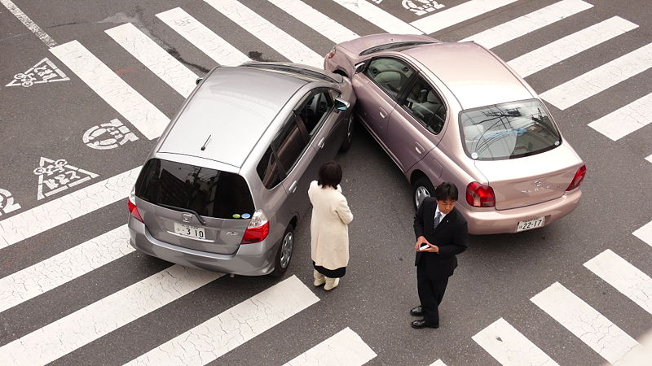
INFERENCE - a logical interpretation based on prior knowledge
* Drawing a conclusion

Slide 11
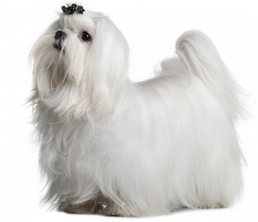
HYPOTHESIS - a proposed explanation, must be testable
Examples:
1. Purina food will reduce a dog's shedding.
2. Putting Miracle Grow on tomato plants will make them produce more tomatoes.
3. The drug Bloodapro will lower a person's blood pressure.
What are some examples of statements that are NOT testable?

Slide 12
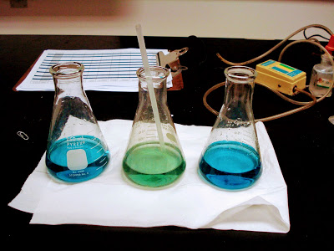
1-2 How Scientists Work
Anchoring Phenomenon:
When air is blown into the flask, the color changes from blue to green.
How would a scientists answer this question?

Slide 13
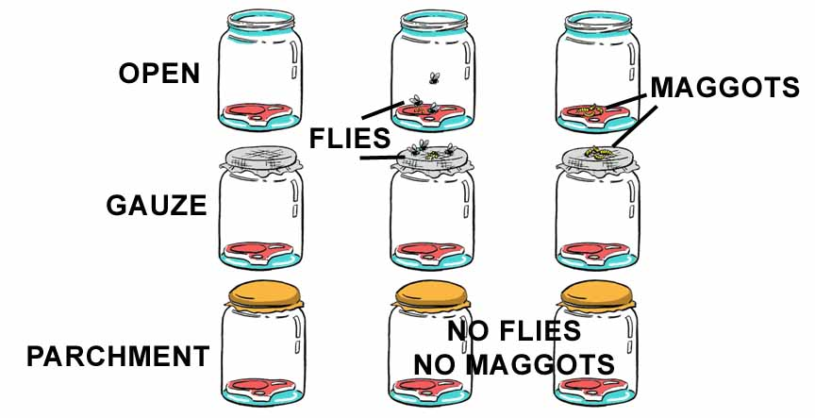
Spontaneous Generation - living things came from nonliving things
Francesco Redi (1668) - experiments with red meat

Slide 14
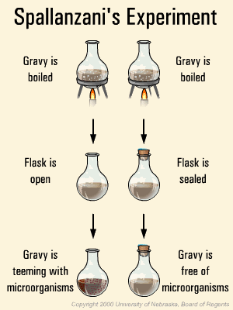
Spallanzani’s Experiment

Slide 15
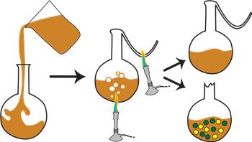
Louis Pasteur (1800's) - S shaped flask

Slide 16
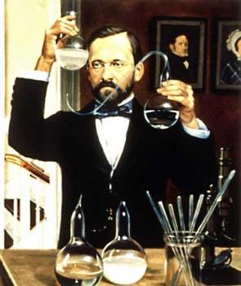
Three Experiments
DISPROVED SPONTANEOUS GENERATION !
Life can only come from other life.

Slide 17
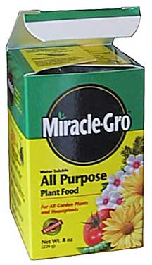
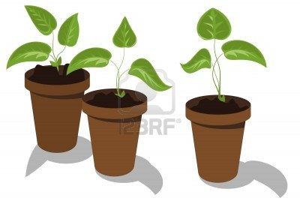
Scientific Method:
1) Ask questions, make observations
2) Gather information
3) Form a hypothesis
4) Set up a controlled experiment (test)
5) Analyze data and draw conclusions
Imagine how you would test a particular fertilizer to determine if the fertilizer would grow taller plants.

Slide 18
Manipulated variable - the thing you change
Responding variable - what you observe or measure

Slide 19
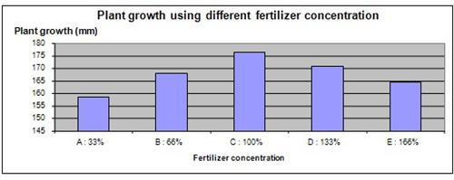
After you have designed your experiment
5)Record and analyze results
6)Draw a conclusion
7)Repeat
Does more fertilizer = better growth?

Slide 20
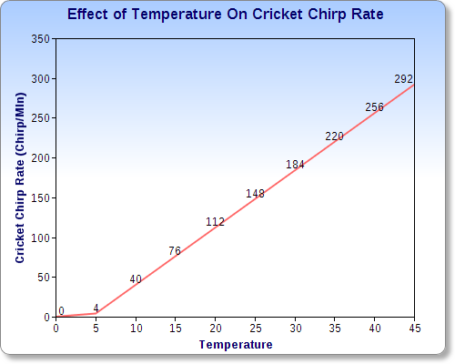
Based on this data, what was the hypothesis?
What should be the conclusion?

Slide 21
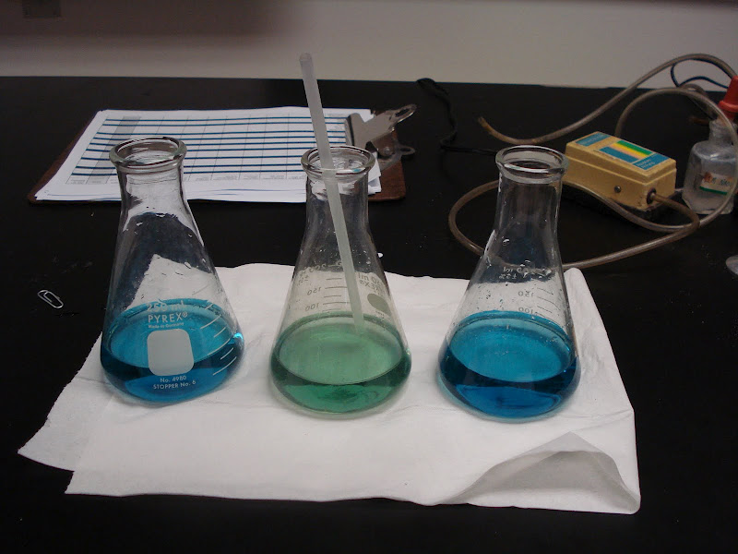
Example of Scientific Method in Action
Question: What causes bromothymol blue to change colors when you blow into the straw?
Discuss with your elbow partner how you would answer this question. You could design an experiment or make other observations.

Slide 22
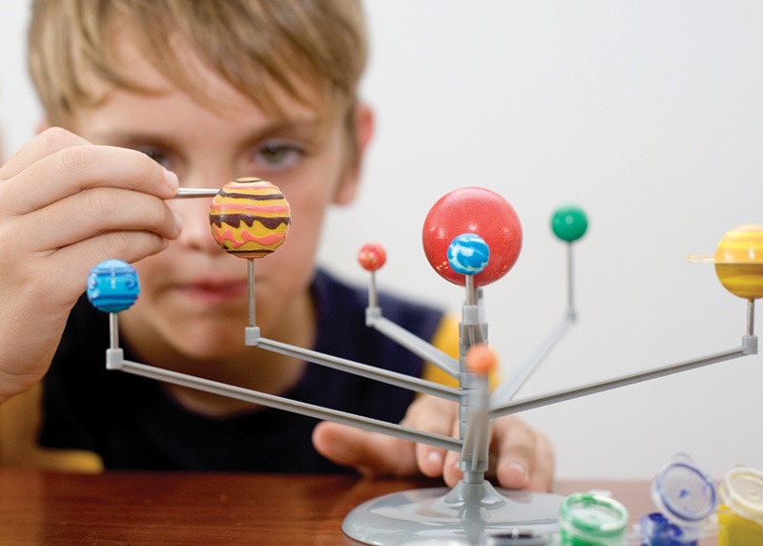
***Field studies, models ***
Field Studies - when nature is observed in its natural state
Models - using computers to make a representation of a process, idea, or structure

Slide 23
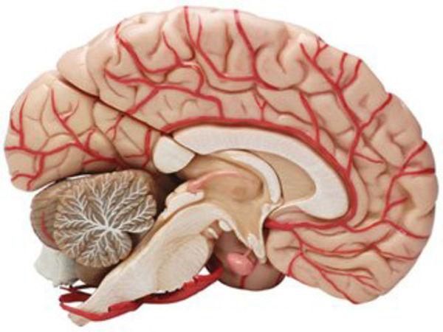
How would you make a model of:
1. Your home
2. This classroom
3. A dissected frog
4. Climate change
5. The solar system
Notes:
http://biol.co/ch1-scibio ← quiz

Slide 24
